Slide 1

Indigenous Technical (Traditional) Knowledge (ITK) in weather forecasting

Slide 2

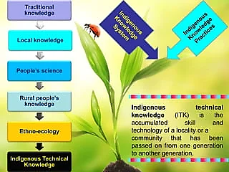
Indigenous Technical Knowledge (ITK)
Knowledge & practices based on people’s accumulated experience in dealing with problems related to various aspects.
Local knowledge is unique to a given culture or society.
One generation to another

Slide 3
Types
Bio Indicator
Non-bio Indicator
Meteorological Indicator

Slide 4
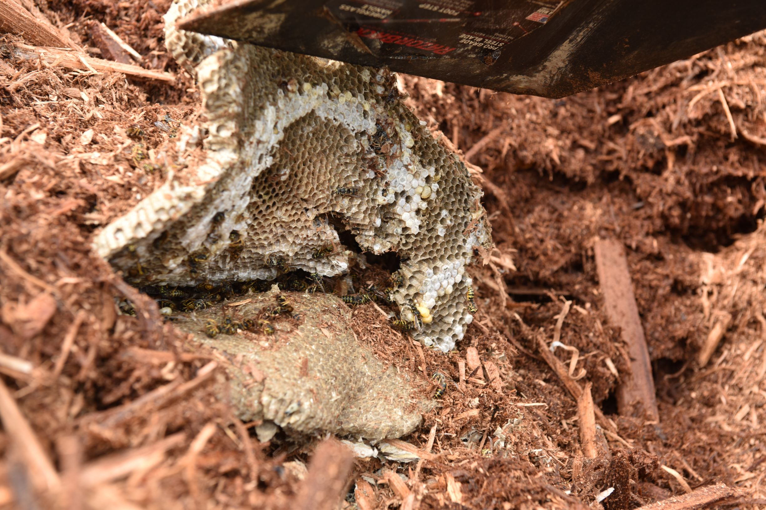

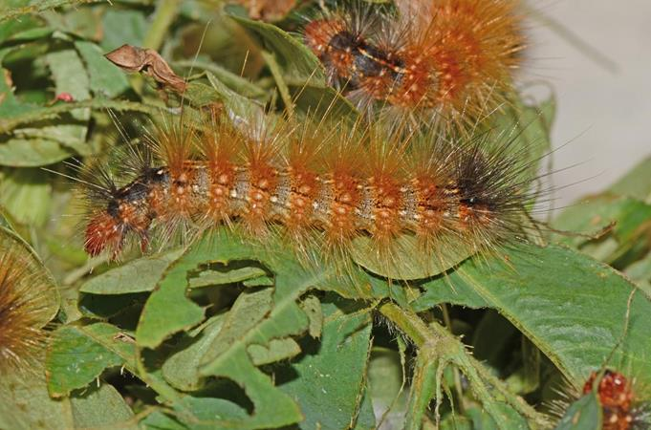
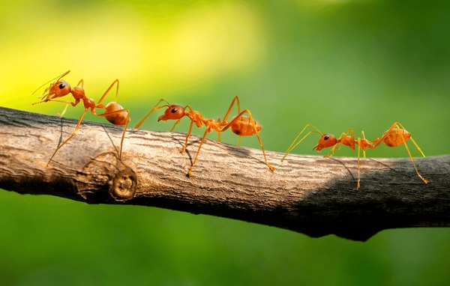
Insects
Dragonfly fly low(rain in few hours)
Termites and ants move in rows (rain in a day)
Active Red hairy caterpillar (Rain in a day)
Wasps build nests near the ground – strong wind

Slide 5
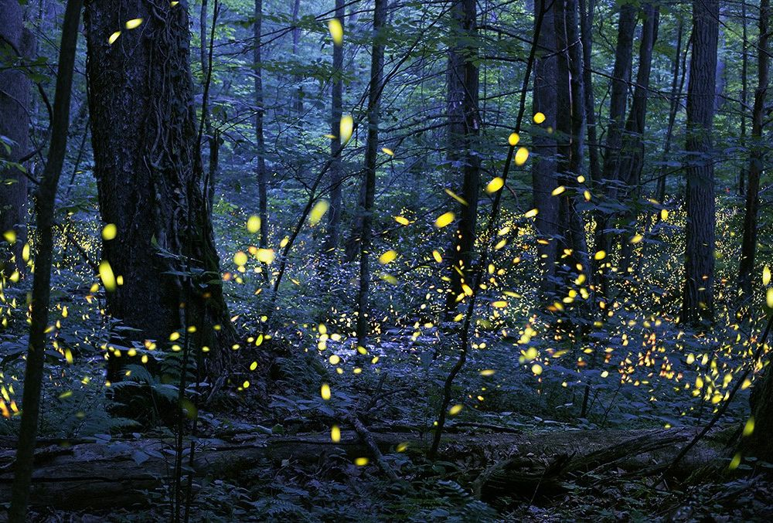
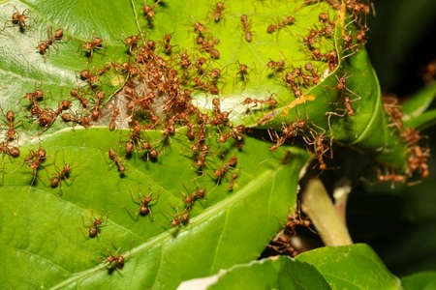
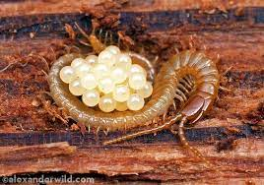
Fireflies dancing at night on the forest is a sign of early start of monsoon.
Appearance of red ants and rapidly increasing size is sign of good rains
Centipedes carrying their eggs and shift them to safer places

Slide 6
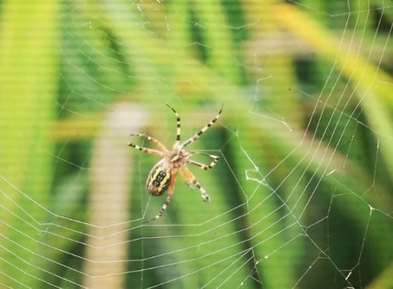
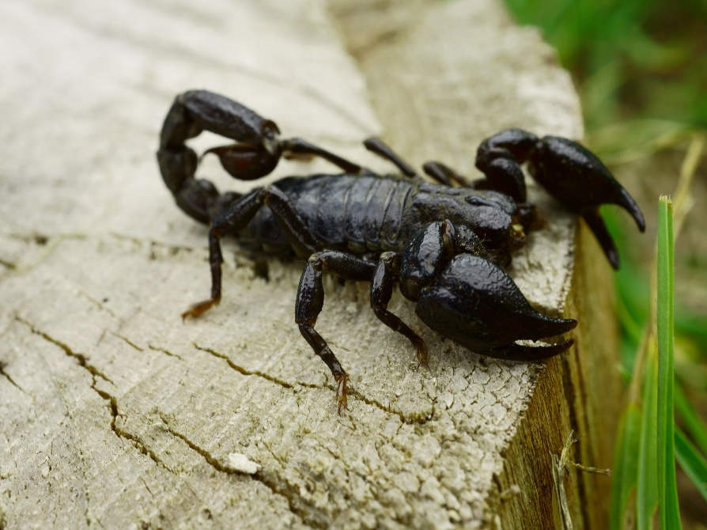
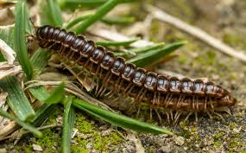
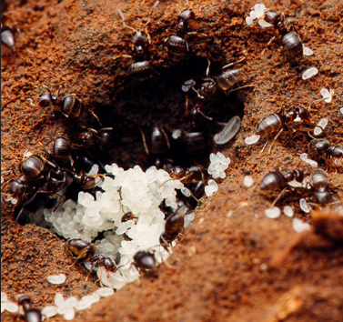
Big black scorpion appears frequently on the farm indicates occurrence of rainfall
Presence of millipedes indicates onset of rainfall
Ants sealing off holes into ant mound indicates rain to fall very soon
Spiders leaving their webs indicates occurrence of rain

Slide 7
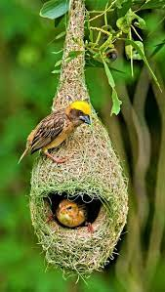
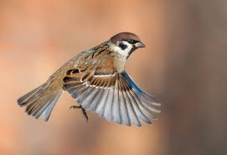
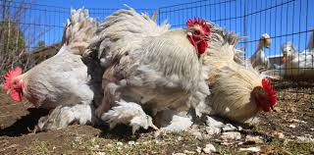
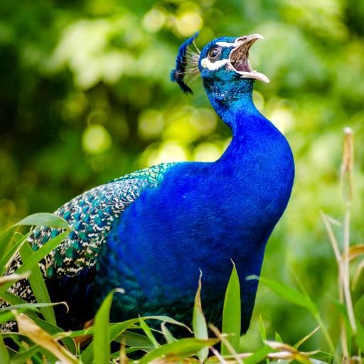
Birds
Positioning of weaver bird nest (low → Drought, high → good monsoon)
Peacock making sound early in the morning, late in the evening
Poultry inserting feathers in the soil
Sparrows flying very low

Slide 8
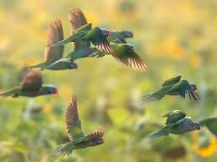
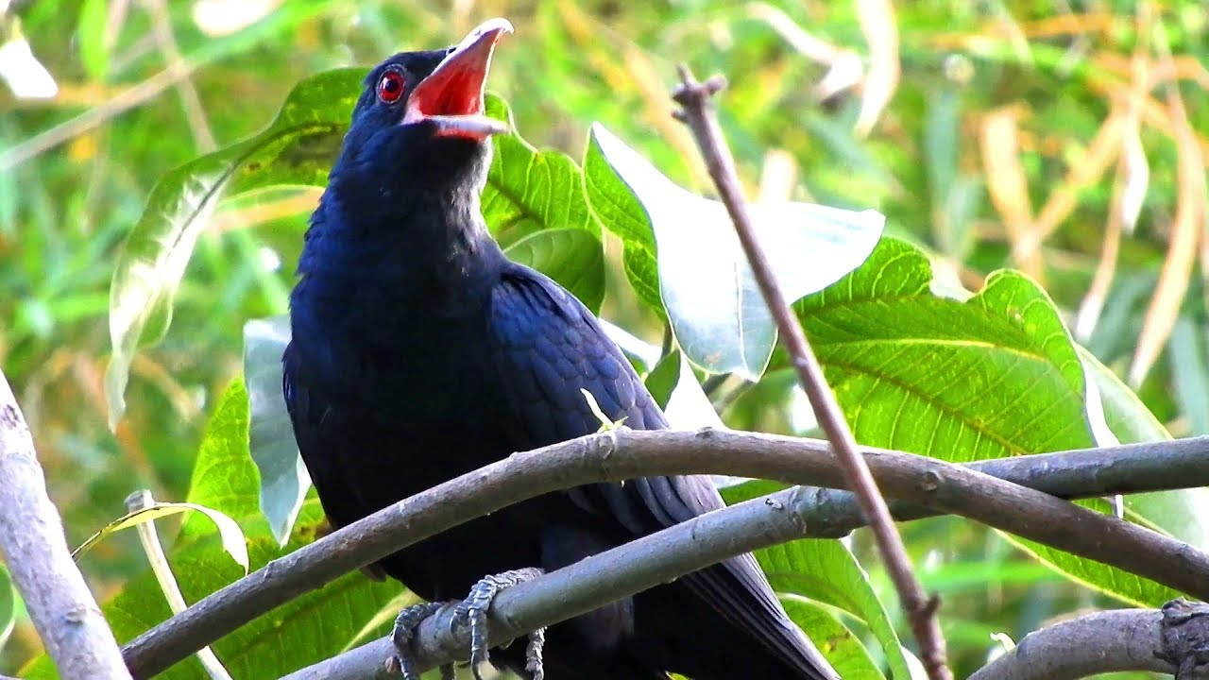
Migration of parrots in north-south direction is the indicator of rain
Singing of black cuckoo is taken as indicator of rainfall

Slide 9
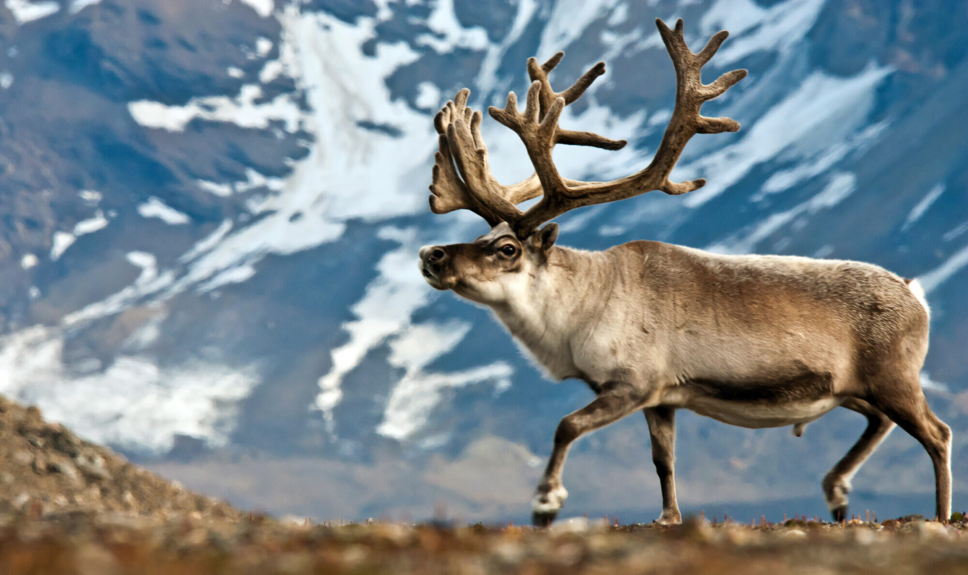
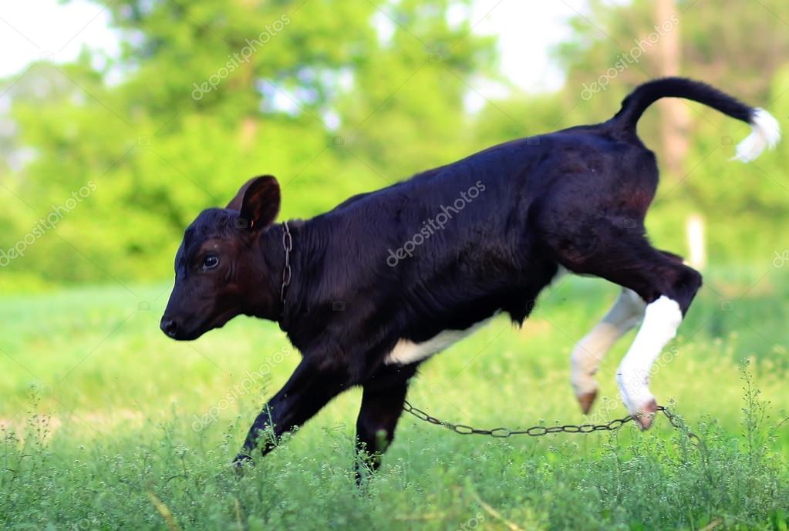
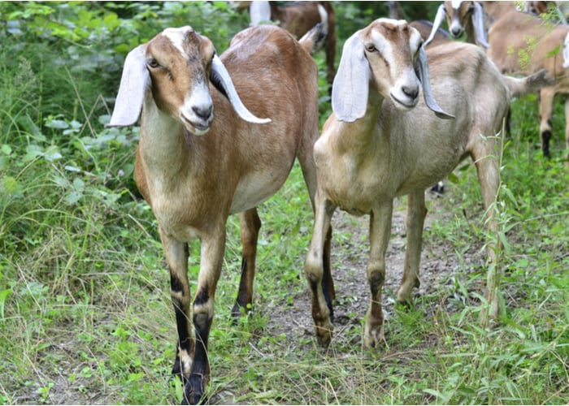

Animals
Flapping of ears by goats
Joyful jumping of cattle
Dogs barking frequently
Movement of reindeer towards higher altitude – Wind speed low

Slide 10
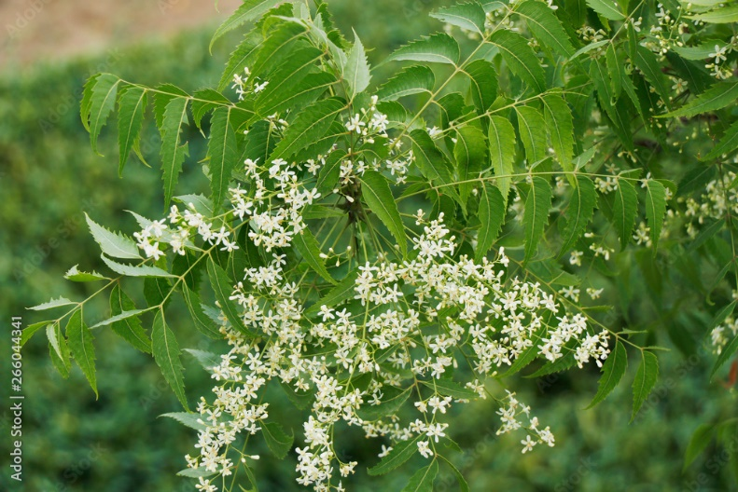
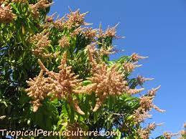
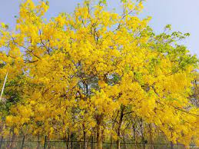
Plants
Flowering of mango tree and sprouting of their leaves
Full bloom of neem tree
Blooming of Amaltas (Cassia fistula) the golden shower tree
Number of seeds in the fruit of buteamonosperma

Slide 11
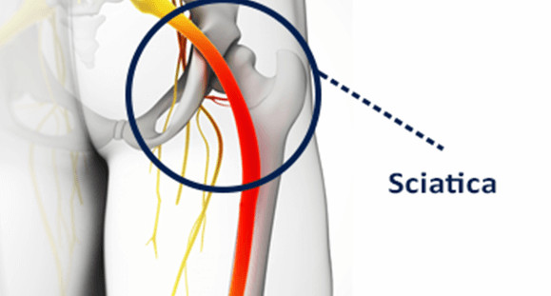
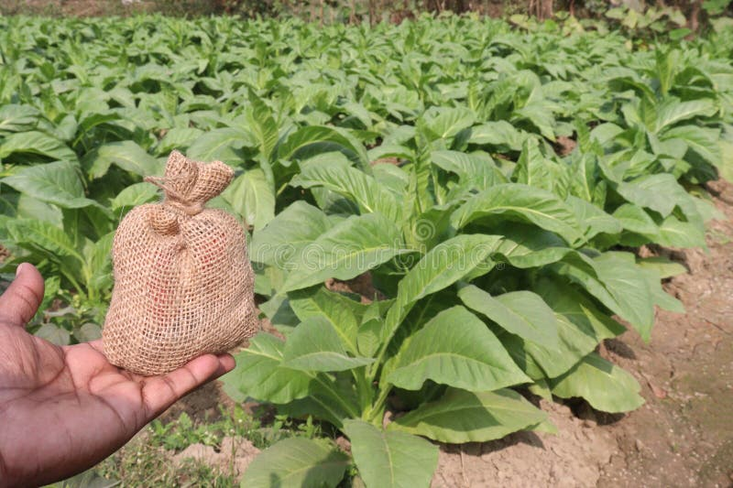
A patient suffering from sciatica is said to be able to fore tell weather phenomena according to their body temperature
More moisture in the “Tambaku” (tobacco) bag of farmers - rainfall within one or two days

Slide 12


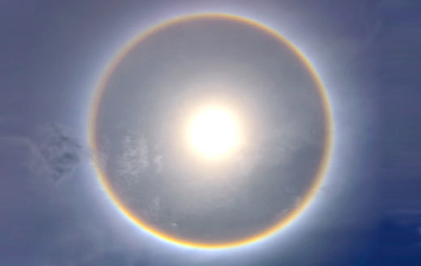
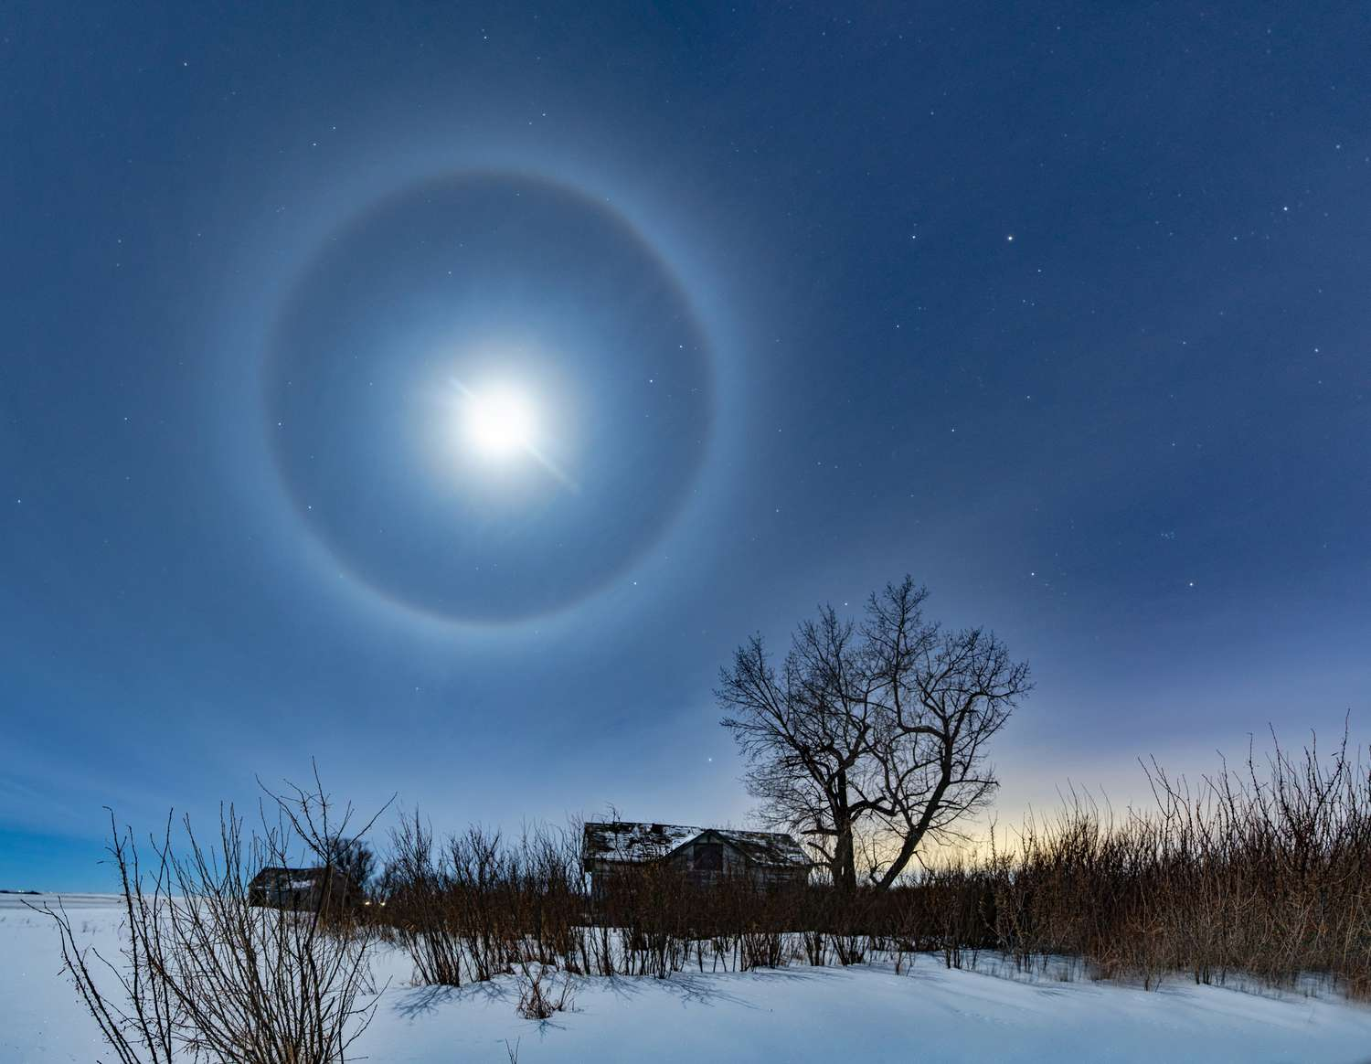
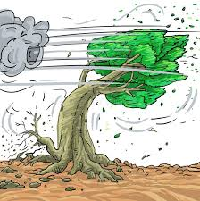
Wind
Strong wind indicates less rainfall in the upcoming season
Appearance of stars, The Sun and The Moon
Early emergence of a star appearing mid-November – Nangakavuji
Spectrum around The Sun or The Moon had a greater diameter

Slide 13
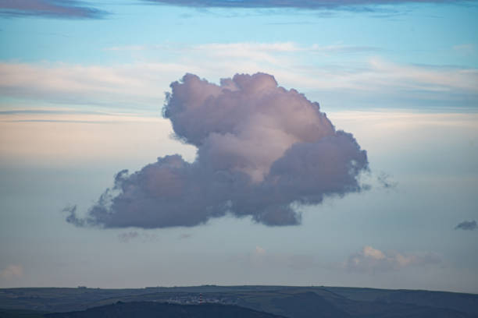

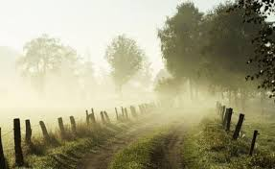
Clouds
Thick and black color clouds arranged perpendicular to the orbit of the sun during the morning hours - Rain
Appearance of reddish colored clouds after a long rainfall – No rainfall in upcoming season
Dew or Mist forms in the morning – no possibility of rain

Slide 14

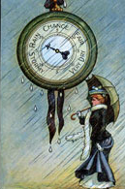
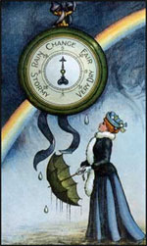

Astrometeorology: An option to improve the accuracy of medium range weather forecast
Ga. Dheebakaran
Associate Professor (Agronomy)
Agro Climate Research Centre
Tamil Nadu Agricultural University
Coimbatore – 641 003, India
Email: gadheebakaran@tnau.ac.in; Mobile: 9443935107

Slide 15
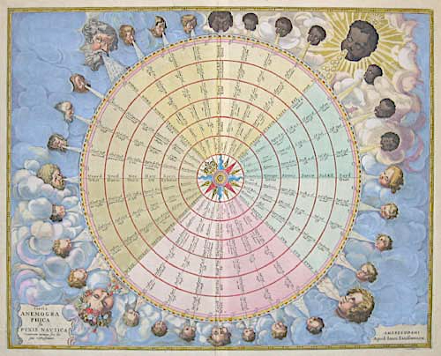
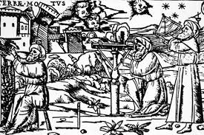
Astrometeorology
Investigation of the supposed relation between the celestial bodies and the weather.
Origin and Etymology: astr- + meteorology
Gifted science from our ancestors
Most popular methods of Astrometeorology
  Antariksha Paddhathi (sky observation - planetary movement)
  Parashara’s Paddhathi (positions of Sun and Moon)
  Brihat Samhita’s – Seasonal rainfall forecast (Occurrence of full moon) .

Slide 16
Current status of Research - International
Astrometeorology reports available from 460 BC.
Mainly for predicting storms and medium range forecast.
Using celestial constellation & lunar movement for prediction.
UK, China, Japan and US are doing Astrometeorology.
Current status of Research - National
Found Astrometeorology records during Vedic period itself.
Kings used astrology to predict rainy season for planning war.
Kautilya’s Arthashastra (3rd BC) contains records of scientific measurement of rainfall with astrology.

Slide 17
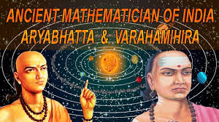
Works of Varahamihira:
"Pancha Siddhantika" or "The Five Astronomical Canons": a treatise on mathematical astronomy that summarized earlier astronomical treatises (Paulsia, Ramaka, Vasishtha, Saura and paitamalia Siddhantika)
"Brihat Samhita" or "The Great Compilation": a comprehensive work on astronomy, astrology, architecture, gemology, agriculture and mathematics
"Brihat Jataka" or "The Great Horoscope": a Hindu astrology text that covers the field of horoscopy
"Laghu Jataka": a shorter version of "Brihat Jataka" that provides an overview of the science of horoscop
"Surya Siddhanta" or "Sun Theory": Astronomical calculations for measuring of star & planet positions
"Yogayatra": a work on astronomy, astrology, architecture, geology, metrology, ecology and mathematic
"Romaka Siddhanta" or "The Doctrine of the Romans": a work based on the epicycle theory of the motions of the Sun and the Moon given by the Greeks
"Paulisa Siddhanta": a work based on the tropical year of Hipparchus and on the Metonic cycle of 19 years

Slide 18
Current status of Research – National ….
Astrological Weather Calendars of Gujarat - Varshneya et al., 2002.
    Yearly skill score: 75 – 79% between 2004 to 2008
Astrological Weather Calendars of Maharashtra - Vaidya (2004).
    Monthly skill score for Jun to Oct varies between 73 - 86 %.
There is accuracy rate of 60-70% and there is always a relevance of ancient wisdom for weather forecasting for improving agro-advisories,’’. (Y.S. Ramakrishna, 2006, CRIDA)
Kerala - Unnikrishnan,T. and G.S.L.H.V.Prasada Rao (2009).
Tamil Nadu Agricultural University is working since 2011, defined astromet rules for rainfall, temperature, solar radiation, wind speed and cyclone.
TNAU developed “Planet Activeness Chart” for hourly weather events (Dheebakaran, 2018)

Slide 19
Why astrometeorology is difficult
Astrological journals (Panjangam) provides general note on rain, hotness and wind, but they are for one location and not specific to agriculture.
Earlier developed astro weather calendars were medium range or seasonal.
Reason for low accuracy in daily prediction is
Considered only the rain responsible planets such as Moon, Venus, Saturn and Neptune.
Not considered the activity (+ve / -ve) of other planets.
Calculations are very cumbersome

Slide 20
Astromet calculation for Tamil Nadu for 385 blocks
Calculations are cumbersome and need location specific calculations for predict rainfall.
One location for 1 hour = 9 planets x 12 angles x 5 strengths x 336 combinations = 181440 calculations
Hourly for one day = 24 x 1.814 lakhs = 43.545 lakh calculations
Six days forecast = 6 x 43.545 lakh = 261.27 lakh
For 385 locations = ????
Astrometeorological software, for multiple locations need to be developed.

Slide 21
Weather event and responsible planets
Planet | Duration | Character
 |  | General | Temperature | Wind | Moisture
Sun | 1 month | Hot | Warm | Still | Dry
Moon | 2.25 days | Rain | Cool | Breeze | Wettest
Mars | 1.5 month | Hot | Hot/Cold | Still/Storm | Wet/Drought
Mercury | 1 month | Wind | Cold | Windy | Dry
Jupiter | 1 year | Hot/Cold | Warm | Calm, Light | Dry
Venus | 1 month | Rain | Pleasant | Light | Rain
Saturn | 2.5 years | Cold | Cold | Still/Storm | Wet/Drought
Uranus | 1.5 years | Hot | Cold Snaps | Gusty | Dry, Lightning
Neptune | 1.5 years | Rain | Cool | Still/Storm | Mist, Fog
Planets are not the cause but have influence on the weather

Slide 22

Strength of planet based on its azimuth and aspect
ASPECT | SYMBOL | DISTANCE | STRENGTH
Conjunction | Ó | Same Longitute | Very Strong
Parallel | P or Par | Same Declination | Very Strong
Opposition | Ȣ | 180⁰ | Very Strong
Trine | ∆ | 120⁰ | Strong
Square or Quadrate | □ | 90⁰ | Strong
Sextile | * | 60⁰ | Moderately Strong
Semi Quardrate |  | 45⁰ | Moderately Strong
Sesqui quadrate |  | 135⁰ | Moderately Strong
Semi Sextile |  | 30⁰ | Week
Quincunx | or | 150⁰ | Wee
Quintile | q | 72⁰ | Week
By Quintile | bq or ± | 144⁰ | Week
Decile or semi Quintile |  | 36⁰ | Very Week

Slide 23
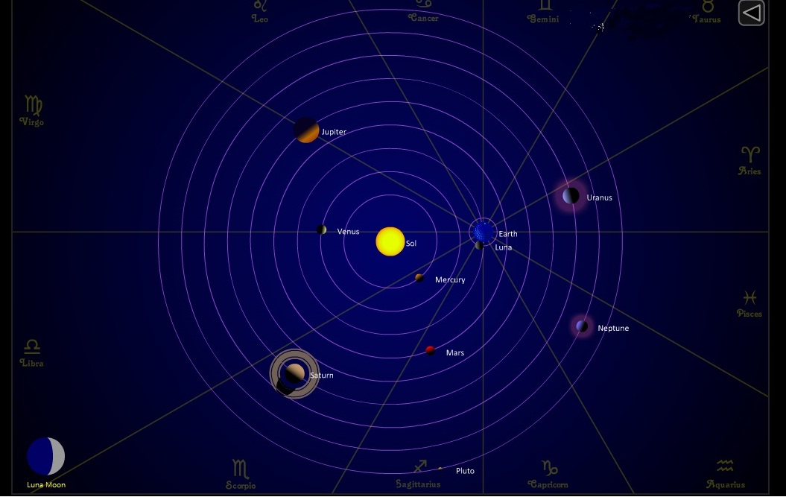
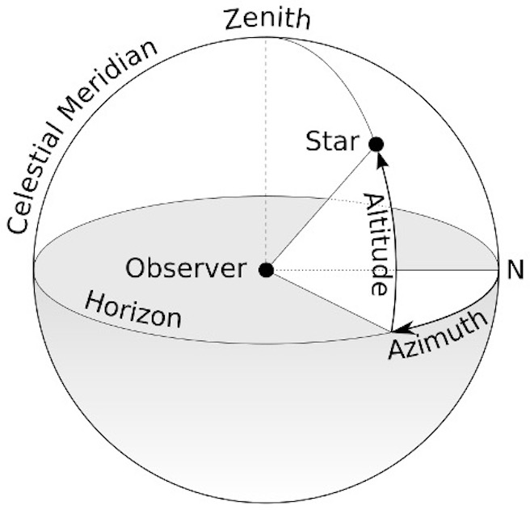
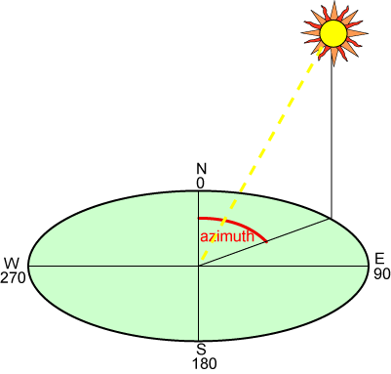
Planet Positions
Azimuth calculation
Azimuth: Angle between true north of observer and the planet
Aspect: Angle between two planets keeping observer as origin.
Ephemeris: Continuous data of azimuth

Slide 24
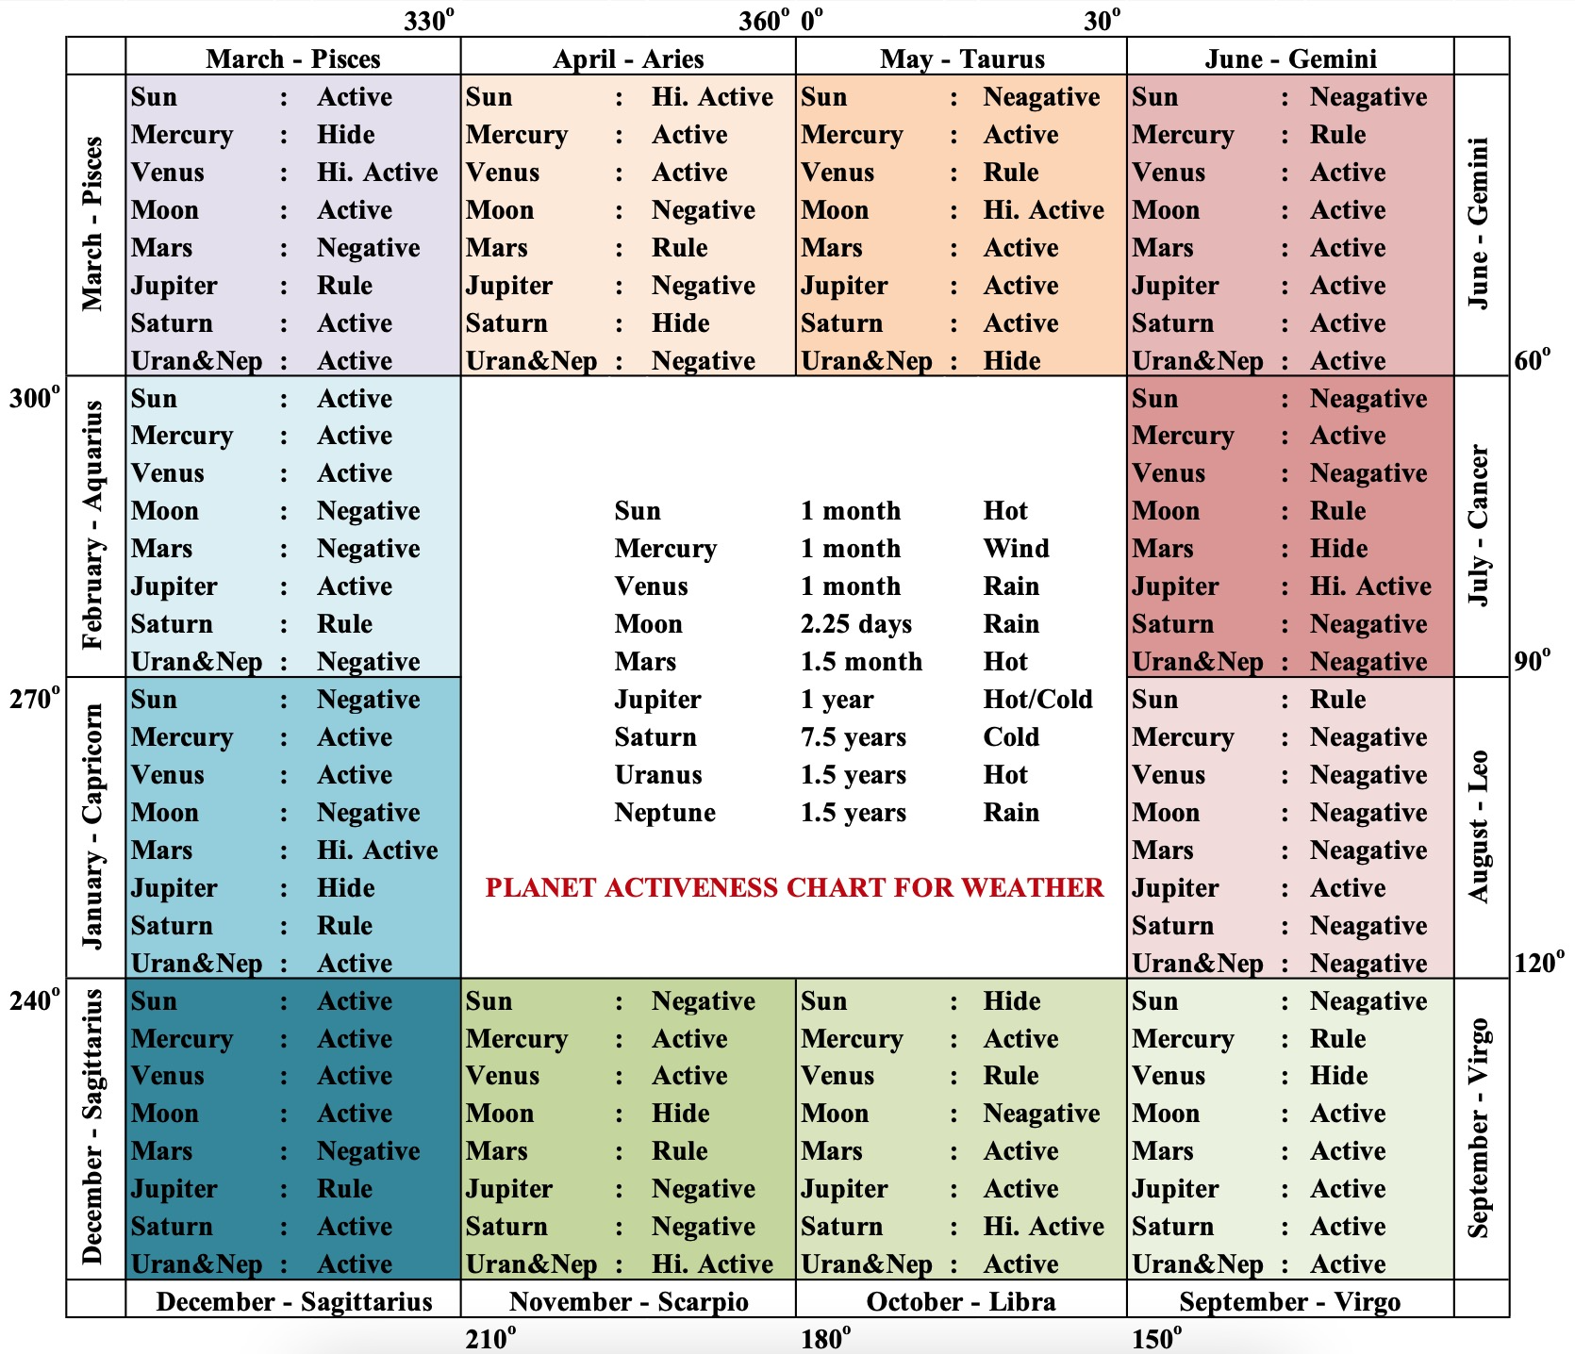
Planet activeness
Planet activeness is a new concept
Based on the information from multiple Tamil “Panjangams”,
Friendliness & Antipathy’ of a Zodiac sign.
Concept is altered as activeness for weather.
Principle is that “Planets’ influence on a location’s weather is not uniform throughout the day and may be positive or negative or null based on their angle to that location”.
Based on that activeness of a planet on weather is classified as negative, inactive, active, obstruct and rule

Slide 25
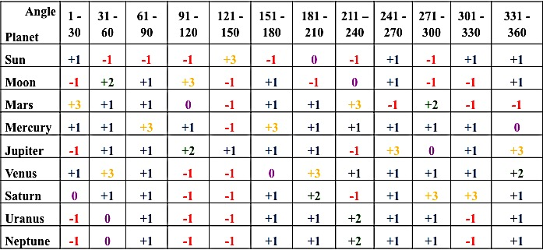
Planet Activeness Chart in Respect to Their Angle from Observer Location
Note: +3 = Ruling; +2 = Highly Active; +1 = Active; 0 = Inactive; -1 = Vagram
(Dheebakaran, 2017)

Slide 26
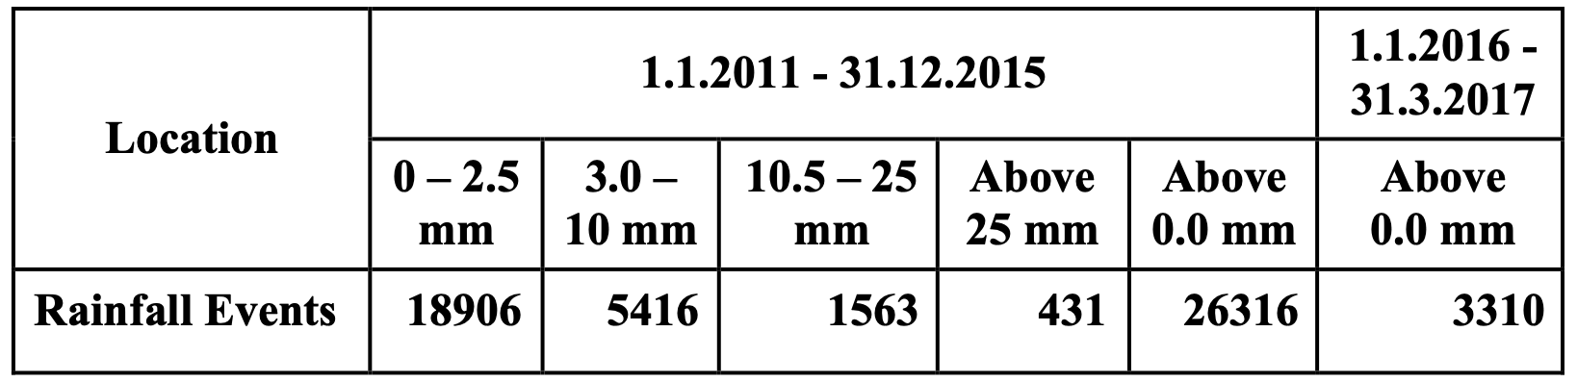
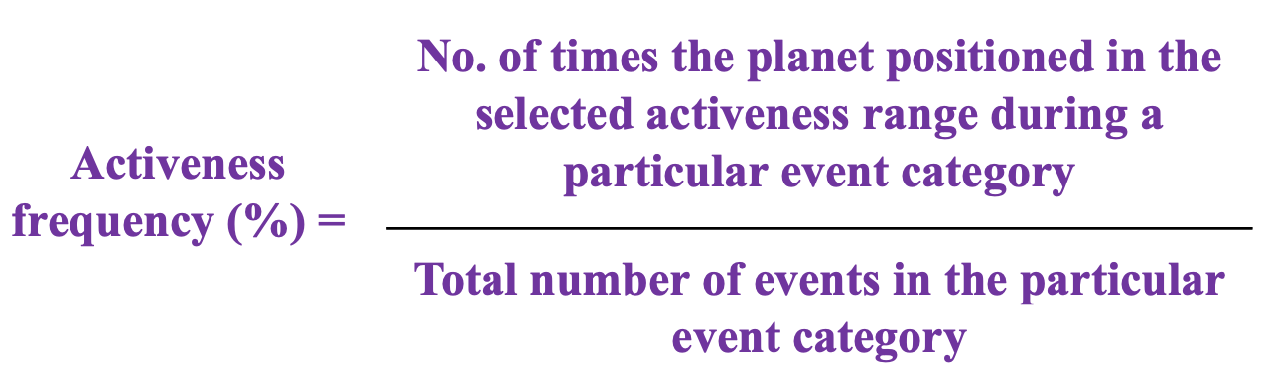
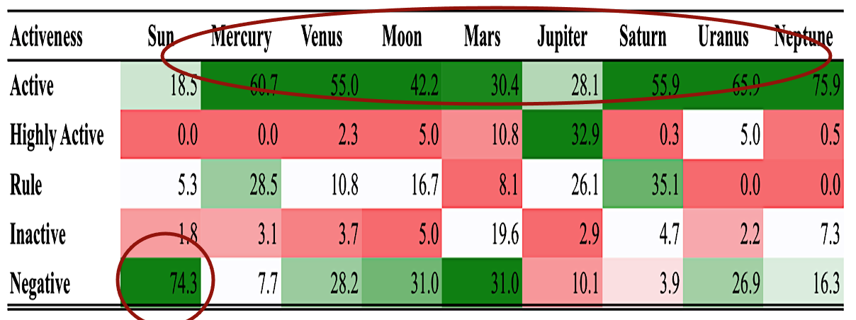
Planet based Astromet study on Rainfall (2018 – 2021)
Planet Aspect on Rainfall
Planet Activeness on Rainfall
Rainfall occurs mostly when Sun is Negative
Active state of Mercury, Venus, Saturn and Neptune are having high influence on rain

Slide 27
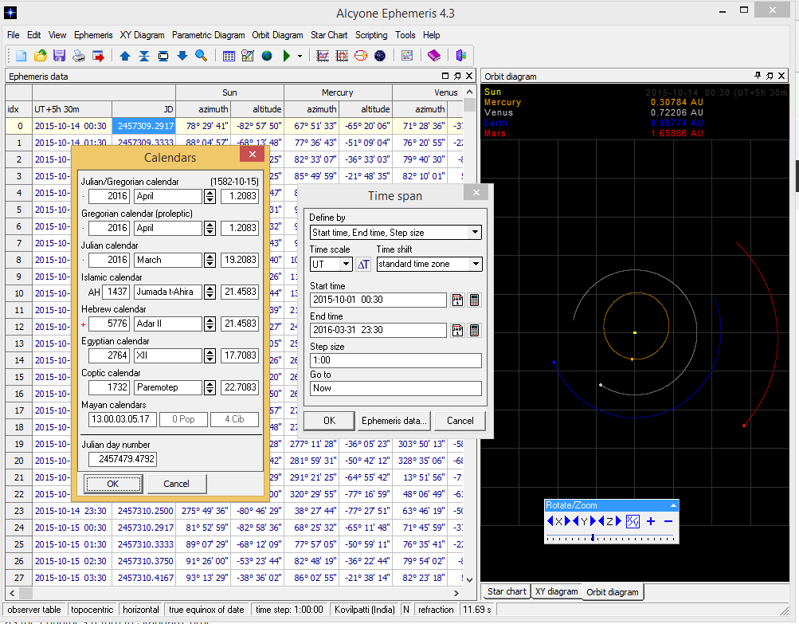
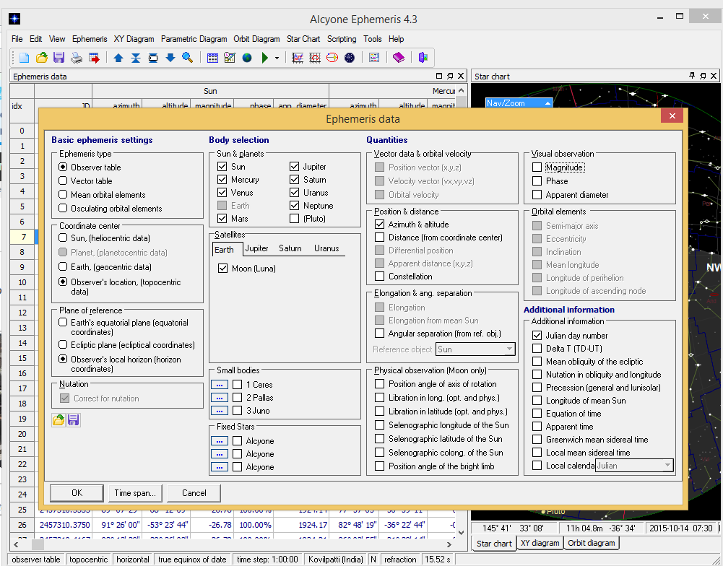
Calculating Ephemeries – Alcyone software

Slide 28
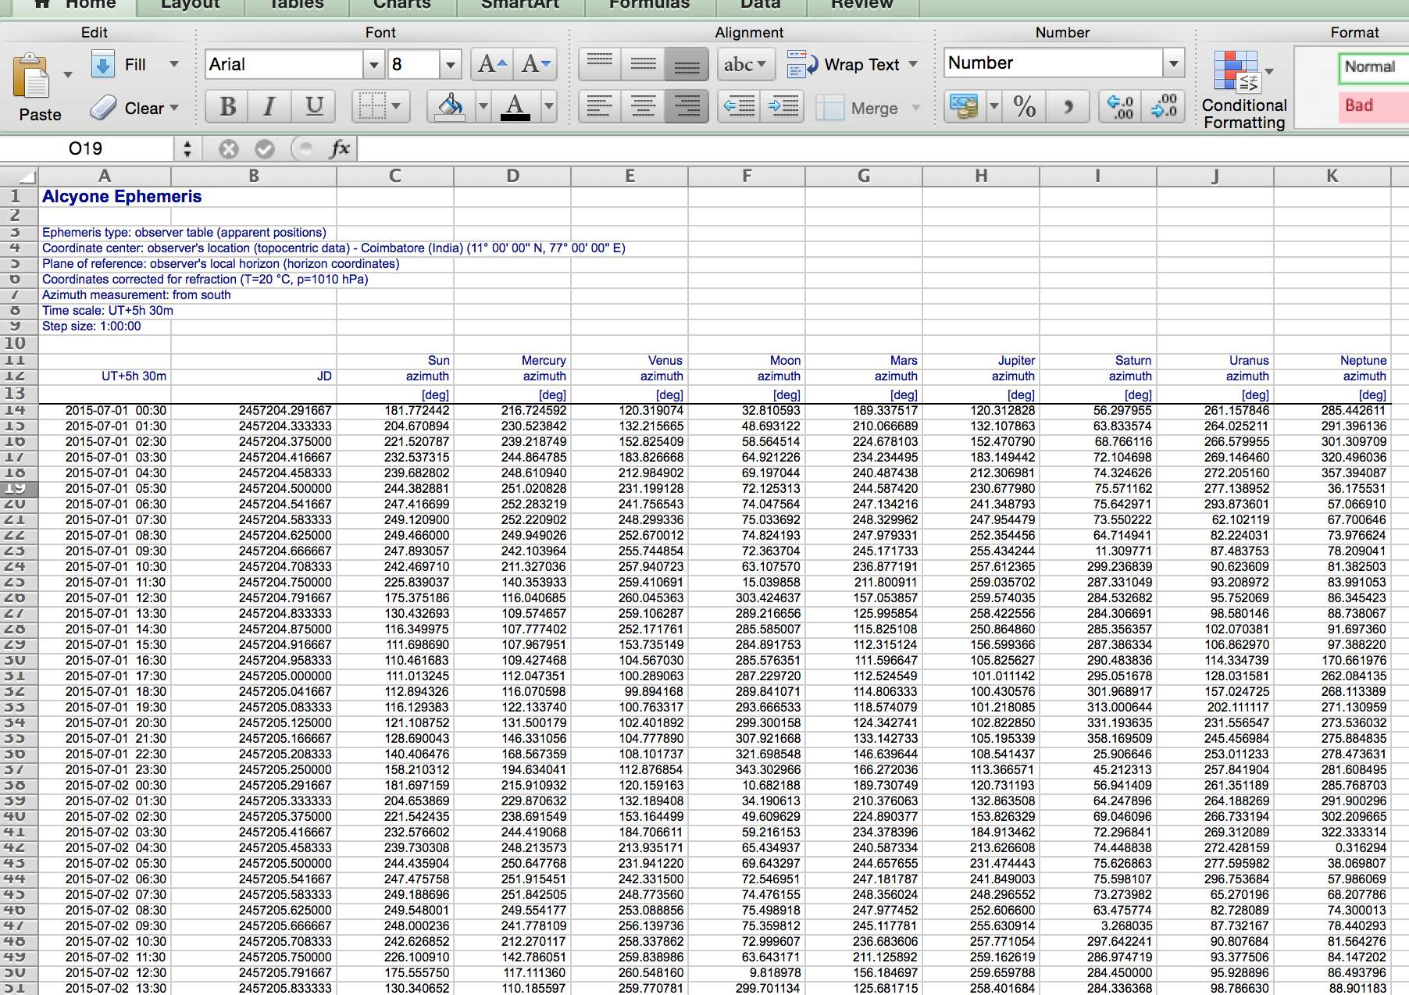

Slide 29
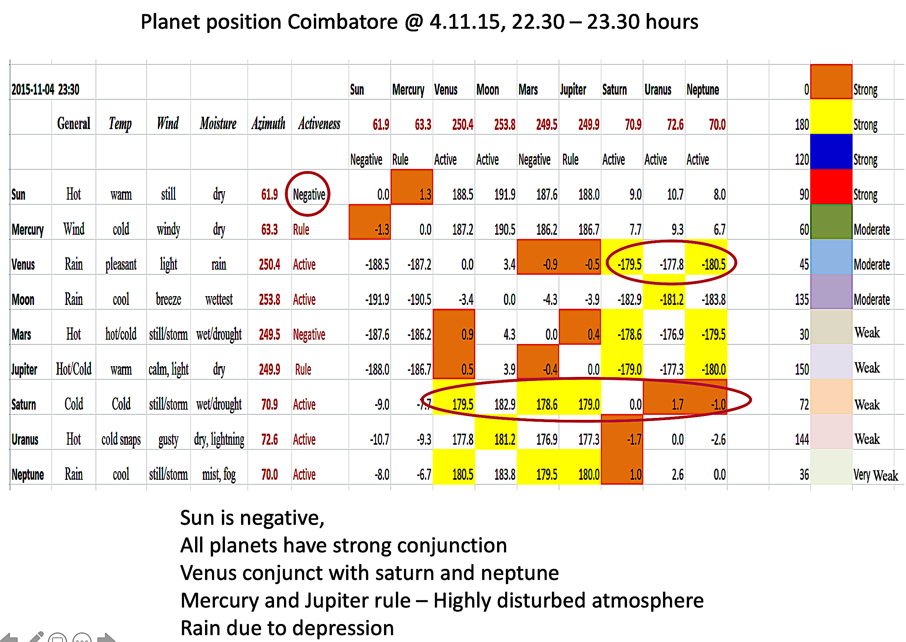
Rainfall Forecast based on planet position – An example
Sun is negative and all planets have strong conjunction
Venus conjunct with Saturn and Neptune
Mercury and Jupiter rule – Highly disturbed atmosphere
Rain due to depression
Result: Good rainfall

Slide 30
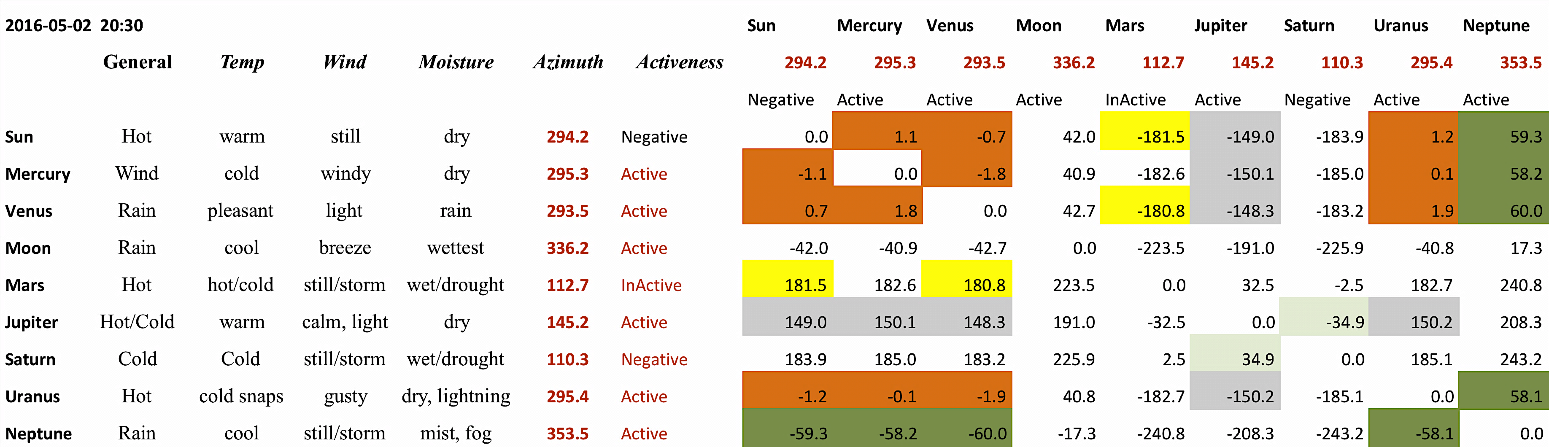
Astrometeorology rainfall prediction
Sun is negative and Mars inactive
Neptune @ 60 with Sun, Mercury and Venus
Saturn is @ 180, but negative
Short and heavy downpour, Thunderstorm

Slide 31
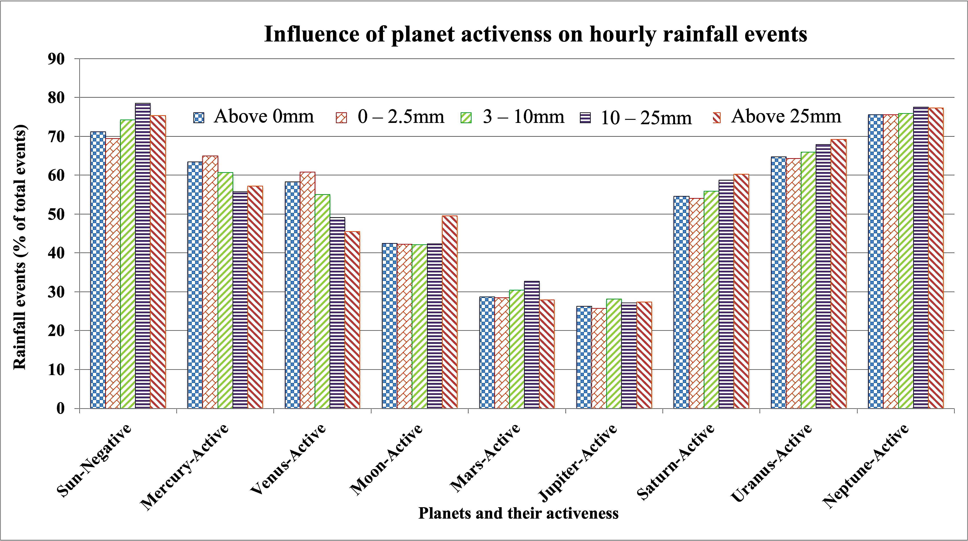
Nearer planets like Mercury & Venus are responsible for short quick downpour and drizzling rains
Faraway planets like Saturn & Neptune are responsible for continuous and heavy rain

Slide 32
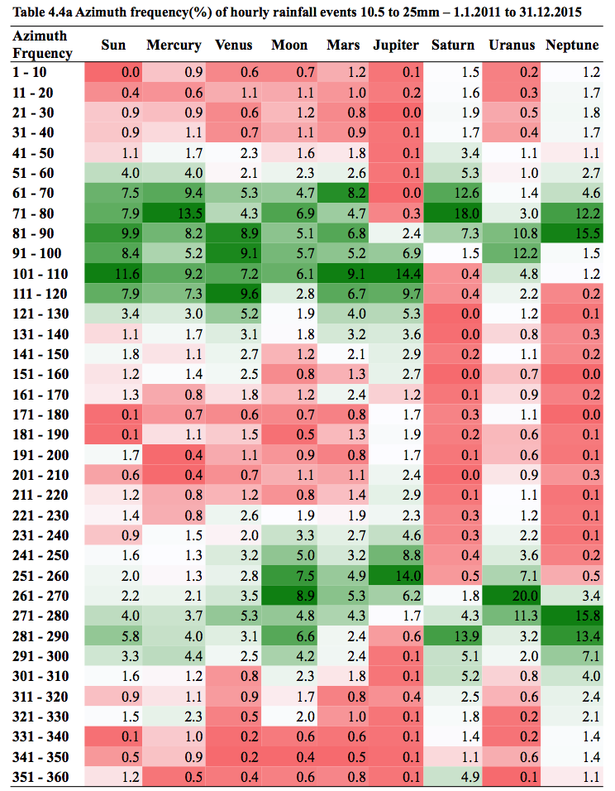

Individual planet azimuth frequency on rainfall events
Planets aspect between 61 - 120º to a particular location have more influence than other aspects.

Slide 33


Rainfall causing Azimuth frequency of individual planet
All events >0mm in an hour
10 – 25 mm in an hour
RF events 0-2.5mm in an hour
RF events >25mm in an hour

Slide 34



Two planets’ aspects frequency in different rainfall events
0-2.5mm
3-10mm
10-25mm

Slide 35
Two planets’ aspects on rainfall events with 10 -25mm per hour

Slide 36


Two planets’ aspects on rainfall events with 10 -25mm per hour

Slide 37
Astromet study on Wind

Slide 38

Hourly Solar Radiation events
The Sun at 31-60 and 61-90 degrees azimuth had greatly influenced the solar radiation event 75.1 to 90 MJ/m²,
whereas, the azimuth of 241-270 and 271-300 degree highly influenced lower solar radiation event of less than 15 MJ/m².
The azimuth of 91-120 degree had higher influence at solar radiation event of 15.1 to 30 MJ/m².

Slide 39

Hourly Temperature events
The Sun Azimuth between 91-120 degrees showed an increasing trend of influence with increase in temperature, which showed no influence for <12ºC and at its maximum influence (68%) for >42ºC.
The Sun’s azimuth 241-270 degrees had started its influence from 18ºC, maximum influence observed for 24-30ºC and become decreasing with increasing temperature.

Slide 40
Salient findings
Planets have good influence on the weather of a location and vary with the azimuth and activeness of individual planet and aspect with another planet.
Rainfall
Among the planets, the Saturn and Neptune at 61 – 90 and 271 – 300 degrees azimuth had higher rainfall influencing capability.
Nearer planet influenced short spell rains, whereas far away planets have continuous long spell for 2 -3 days.
Active state of Venus, Saturn and Neptune, while Negative state of Sun and Mars had induced rainfall events.
Wind speed
Irrespective of planet, the azimuth range of 61 – 120 degree and 240 – 300 degree had good influence on the wind speeds in the study locations.
In particular, the planets at 100-120 degree azimuth had increased influence on the increasing wind speed than other angle.
Among the planets, Neptune and Mercury had higher number of wind speed influencing capability.
Active Mercury, Venus, Moon, Mars, Jupiter & Uranus or ruling Saturn increased the wind speed of a location.

Slide 41

Temperature
Temperature and solar radiation events had concentrated in 61-120 and 241-300 degree azimuth.
Presence of the Sun, Mercury, Venus, the Moon and Neptune at 271-300 degree azimuth, Mars at 61-90, Jupiter at 120-150, Saturn at 301-330, Uranus at 211-240 degree azimuth had also influenced lower temperature events.
High temperature events (above 36ºC) were observed when the Sun, Mercury, Venus, the Moon, Mars, Jupiter and Uranus were at 91-120 degree azimuth. Whereas, Saturn at 271-300 and Neptune at 61-90 degree had high influence on high temperature events.
Solar radiation
Neptune followed by Saturn, Jupiter, Uranus and the Sun at 271-300 degree azimuth had influenced the lower radiation.
In contrast the 61-90 degree azimuth of the Sun, Mercury, Venus, the Moon, Mars, Jupiter and Uranus had influence on the higher solar radiation event (>60MJ/m²).

Slide 42
Conclusion
Astrometeorology could be a good option for alternate forecasting method to numerical weather forecast.
Hybrid forecast developed by integrating the astrometeorology with numerical weather forecasting and probability method will improve the weathr prediction accuracy and critical success index of the forecast.
By combining the astrometeorology with other methods of forecast will increase usability of forecast in agriculture by reducing the false alarms.
Way forward
Spatial variations in the astrometeorological forecast accuracy need to be narrow down by studying in detail.

Slide 43



Slide 44



Slide 45



Slide 46


Slide 47


Scientist involved
Dr. N. Maragatham
Dr. Ga. Dheebakaran
Lunar phases on the productivity and quality of rice varieties
Grain yield
Traditional (Kullakar & Karunkuruvai) & Conventional (ADT 43 & ASD 16)
Sowing Day: New moon, 1st Quarter, Full moon, 3rd Quarter
Karunkuruvai & ADT 43 responded positively to lunar phases
Sowing at 3rd Qtr , planted at 1st Qtr & flowering at full moon performed better
Next best sowing time is new moon & 1st quarter sown.
For Information
Sowing of rice during 3rd quarter or planting during 1st quarter produce higher yield

Slide 48


